Slide 1
AVL Tree Lecture 11

Slide 2
Balanced binary tree
The disadvantage of a binary search tree is that its height can be as large as N-1
Time needed to perform insertion and deletion and many other operations can be O(N) in the worst case
Goal is to keep the height of a binary search tree balanced
Such trees are called balanced binary search trees. Examples are AVL tree, red-black tree

Slide 3
AVL Tree
Named after Adelson-Velskii and Landis
The first dynamically balanced trees
Its Binary search tree with balance condition in which the sub-trees of each node can differ by at most 1 in their height i.e in the range -1 to 1

Slide 4
Balance Factor
The value of the field is the difference between the height of the right and left subtrees of the node
balanceFactor = height(right-subtree) - height(left-subtree)
If balanceFactor is negative, the node is "heavy on the left" since the height of the left subtree is greater than the height of the right subtree
With balanceFactor positive, the node is "heavy on the right"
A balanced node has balanceFactor = 0

Slide 5
Rotations
When the tree structure changes (e.g., insertion or deletion), we need to transform the tree to restore the AVL tree property
This is done by using single rotations or double rotations
y
x
x
y
C
A
C
B
B
A
Before Rotation
After Rotation

Slide 6
Rotations
Since an insertion/deletion involves adding/deleting a single node, this can only increase/decrease the height of some subtree by 1
If the AVL tree property is violated at a node x, it means that the heights of left(x) ad right(x) differ by exactly 2
Rotation will be applied to x to restore the AVL tree property

Slide 7
Rebalancing
Suppose the node to be rebalanced is X. There are 4 cases that we might have to fix (two are the mirror images of the other two):
An insertion in the left subtree of the left child of X
An insertion in the right subtree of the left child of X
An insertion in the left subtree of the right child of X
An insertion in the right subtree of the right child of X

Slide 8
Balancing Operations: Rotations
Case 1 and case 4 are symmetric and requires the same operation for balance
Cases 1,4 are handled by single rotation
Case 2 and case 3 are symmetric and requires the same operation for balance
Cases 2,3 are handled by double rotation

Slide 9
Single Rotation
A single rotation switches the roles of the parent and child while maintaining the search order
Rotate between a node and its child
Child becomes parent. Parent becomes right child in case 1, left child in case 4

Slide 10
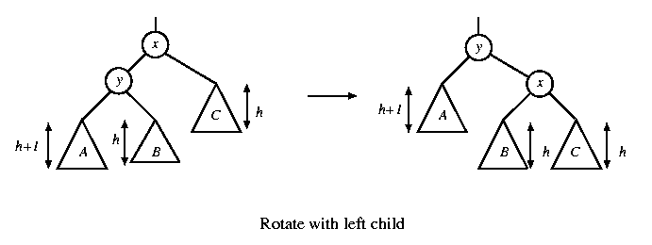
Single rotation
The new key is inserted in the subtree A.
The AVL-property is violated at x
Height of left(x) is h+2
Height of right(x) is h

Slide 11
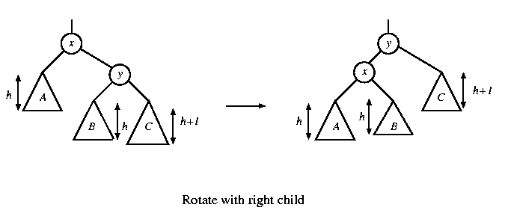
Single rotation
The new key is inserted in the subtree C
The AVL-property is violated at x
Single rotation takes O(1) time.
Insertion takes O(log N) time.

Slide 12
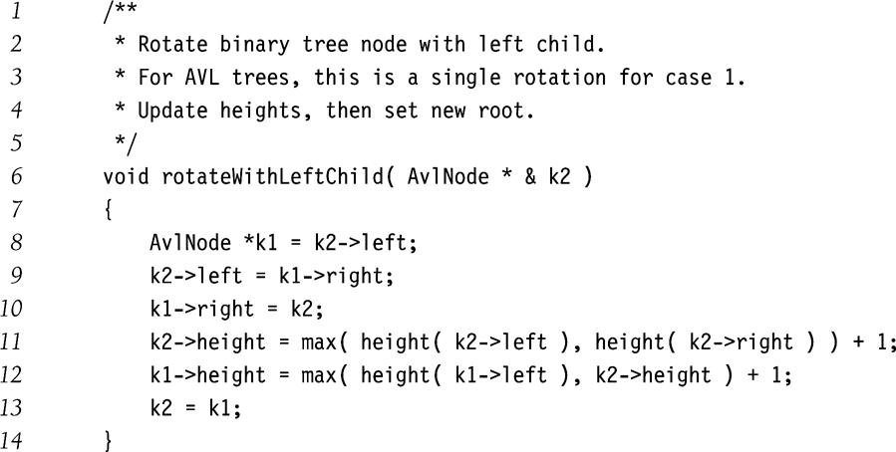
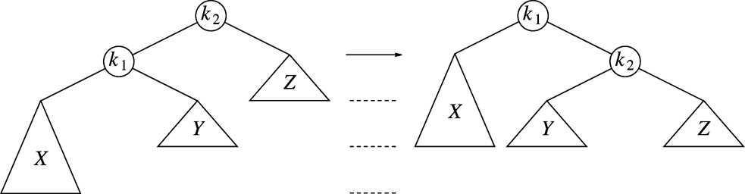
Single Rotation

Slide 13
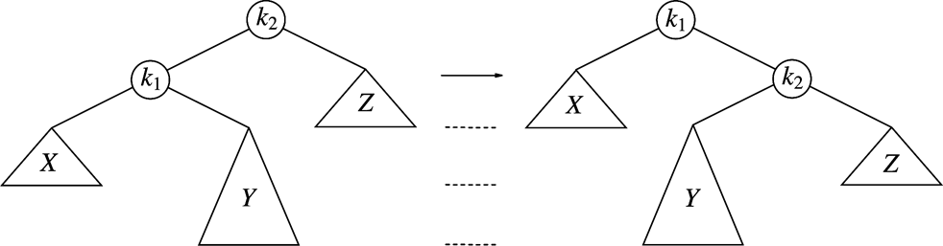
Single Rotation Will Not Work for the Other Case
For case 2
After single rotation, k₁ still not balanced
Double rotations needed for case 2 and case 3

Slide 14
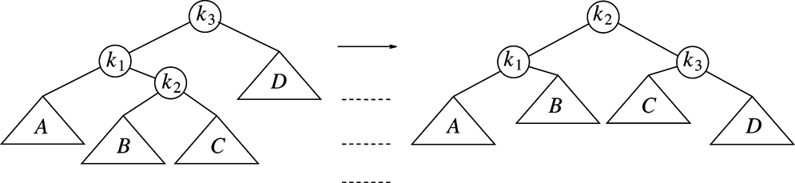
Double Rotation
Left-right double rotation to fix case 2
First rotate between k₁ and k₂
Then rotate between k₂ and k₃
Case 3 is similar

Slide 15
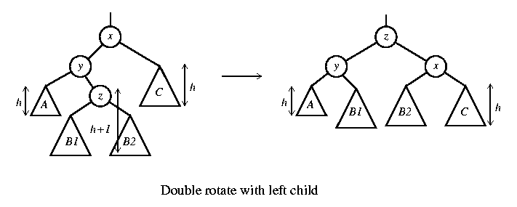
Double rotation
The new key is inserted in the subtree B1 or B2
The AVL-property is violated at x
x-y-z forms a zig-zag shape

Slide 16
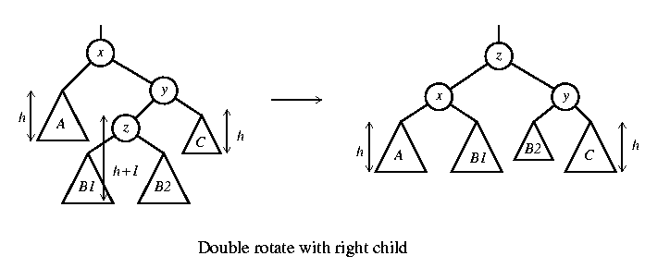
Double rotation
The new key is inserted in the subtree B1 or B2
The AVL-property is violated at x

Slide 17
Node declaration for AVL trees
template <class Comparable>
class AvlTree;
template <class Comparable>
class AvlNode
{
Comparable element;
AvlNode *left;
AvlNode *right;
int height;
AvlNode( const Comparable & theElement, AvlNode *lt,
AvlNode *rt, int h = 0 )
: element( theElement ), left( lt ), right( rt ),
height( h ) { }
friend class AvlTree<Comparable>;
};

Slide 18
Height
template class <Comparable>
int AvlTree<Comparable>::height( AvlNode<Comparable> *t) const
{
return t == NULL ? -1 : t->height;
}

Slide 19
Double Rotation
/**
* Double rotate binary tree node: first left child.
* with its right child; then node k3 with new left child.
* For AVL trees, this is a double rotation for case 2.
* Update heights, then set new root.
*/
template <class Comparable>
void AvlTree<Comparable>::doubleWithLeftChild( AvlNode<Comparable> * & k3 ) const
{
rotateWithRightChild( k3->left );
rotateWithLeftChild( k3 );
}

Slide 20
/* Internal method to insert into a subtree.
* x is the item to insert.
* t is the node that roots the tree.
*/
template <class Comparable>
void AvlTree<Comparable>::insert( const Comparable & x, AvlNode<Comparable> * & t ) const
{
if( t == NULL )
t = new AvlNode<Comparable>( x, NULL, NULL );
else if( x < t->element )
{
insert( x, t->left );
if( height( t->left ) - height( t->right ) == 2 )
if( x < t->left->element )
rotateWithLeftChild( t );
else
doubleWithLeftChild( t );
}
else if( t->element < x )
{
insert( x, t->right );
if( height( t->right ) - height( t->left ) == 2 )
if( t->right->element < x )
rotateWithRightChild( t );
else
doubleWithRightChild( t );
}
else
; // Duplicate; do nothing
t->height = max( height( t->left ), height( t->right ) ) + 1;
}

Slide 21
Insertion
First, insert the new key as a new leaf just as in ordinary binary search tree
Then trace the path from the new leaf towards the root. For each node x encountered, check if heights of left(x) and right(x) differ by at most 1
If yes, proceed to parent(x). If not, restructure by doing either a single rotation or a double rotation
For insertion, once we perform a rotation at a node x, we won’t need to perform any rotation at any ancestor of x

Slide 22
Insertion
Let x be the node at which left(x) and right(x) differ by more than 1
Assume that the height of x is h+3
There are 4 cases
Height of left(x) is h+2 (i.e. height of right(x) is h)
Height of left(left(x)) is h+1 ⇒ single rotate with left child
Height of right(left(x)) is h+1 ⇒ double rotate with left child
Height of right(x) is h+2 (i.e. height of left(x) is h)
Height of right(right(x)) is h+1 ⇒ single rotate with right child
Height of left(right(x)) is h+1 ⇒ double rotate with right child

Slide 23
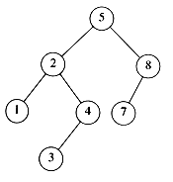
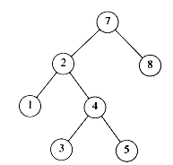
AVL tree?
YES
Each left sub-tree has height 1 greater than each right sub-tree
NO
Left sub-tree has height 3, but right sub-tree has height 1

Slide 24
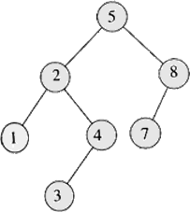
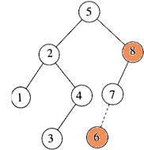
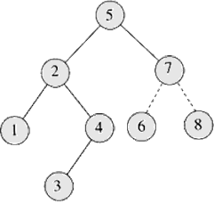
Insertion
Insert 6
Imbalance at 8
Perform rotation with 7

Slide 26
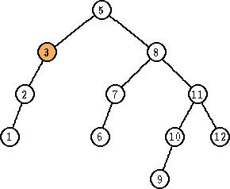
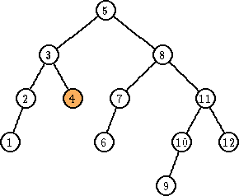
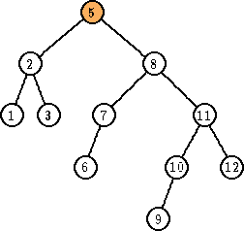
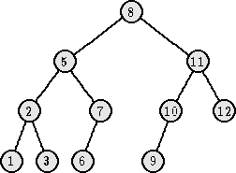
Deletion
Delete 4
Imbalance at 3
Perform rotation with 2
Imbalance at 5
Perform rotation with 8

Slide 28
AVL Trees (Adelson – Velskii – Landis)
20
16
25
7
18
30
5
17
19

Slide 29
AVL Trees
20
16
25
Not AVL tree
7
18
30
5
17
19
27

Slide 30
AVL Tree Rotations
Single rotations: insert 14, 15, 16, 13, 12, 11, 10
First insert 14 and 15:
14
15
Now insert 16.

Slide 31
AVL Tree Rotations
Single rotations:
Inserting 16 causes AVL violation
14
15
16
Need to rotate

Slide 32
AVL Tree Rotations
Single rotations:
14
15
16

Slide 33
AVL Tree Rotations
Single rotations:
Rotation restores AVL balance
15
14
16

Slide 34
AVL Tree Rotations
Single rotations:
Now insert 13 and 12
15
14
16
13
12
AVL violation - need to rotate

Slide 35
AVL Tree Rotations
Single rotations:
15
14
16
13
12

Slide 36
AVL Tree Rotations
Single rotations:
15
13
16
12
14
Now insert 11

Slide 37
AVL Tree Rotations
Single rotations:
15
13
16
12
14
11
AVL violation – need to rotate

Slide 38
AVL Tree Rotations
Single rotations:
15
13
16
12
14
11

Slide 39
AVL Tree Rotations
Single rotations:
13
12
15
14
16
11
Now insert 10

Slide 40
AVL Tree Rotations
Single rotations:
13
12
15
14
16
11
10
AVL violation – need to rotate

Slide 41
AVL Tree Rotations
Single rotations:
13
12
15
14
16
11
10

Slide 42
AVL Tree Rotations
Single rotations:
13
11
15
10
12
14
16
AVL balance restored

Slide 43
AVL Tree Rotations
Double rotations: insert 1, 2, 3, 4, 5, 7, 6, 9, 8
First insert 1 and 2
13
11
15
10
12
14
16

Slide 44
AVL Tree Rotations
Double rotations:
13
AVL violation - rotate
15
11
14
16
10
12
1
2

Slide 45
AVL Tree Rotations
Double rotations:
13
11
15
14
16
10
12
1
2

Slide 46
AVL Tree Rotations
Double rotations:
13
AVL balance restored
11
15
2
12
14
16
1
10
Now insert 3

Slide 47
AVL Tree Rotations
Double rotations:
13
AVL violation – rotate
11
15
2
12
14
16
1
10
3

Slide 48
AVL Tree Rotations
Double rotations:
13
11
15
2
12
14
16
1
10
3

Slide 49
AVL Tree Rotations
Double rotations:
13
AVL balance restored
10
15
2
11
14
16
1
3
12
Now insert 4

Slide 50
AVL Tree Rotations
Double rotations:
13
AVL violation - rotate
10
15
2
11
14
16
1
3
12
4

Slide 51
AVL Tree Rotations
Double rotations:
13
10
15
2
11
14
16
1
3
12
4

Slide 52
AVL Tree Rotations
Double rotations:
10
2
13
1
3
11
15
4
12
14
16
Now insert 5

Slide 53
AVL Tree Rotations
Double rotations:
10
2
13
1
3
11
15
4
12
14
16
5
AVL violation – rotate

Slide 54
AVL Tree Rotations
Single rotations:
10
2
13
1
3
11
15
4
12
14
16
5

Slide 55
AVL Tree Rotations
Single rotations:
AVL balance restored
10
2
13
1
4
11
15
3
5
12
14
16
Now insert 7

Slide 56
AVL Tree Rotations
Single rotations:
AVL violation – rotate
10
2
13
1
4
11
15
3
5
12
14
16
7

Slide 57
AVL Tree Rotations
Single rotations:
10
2
13
1
4
11
15
3
5
12
14
16
7

Slide 58
AVL Tree Rotations
Double rotations:
AVL balance restored
10
4
13
2
5
11
15
7
12
14
16
1
3
Now insert 6

Slide 59
AVL Tree Rotations
Double rotations:
AVL violation - rotate
10
4
13
2
5
11
15
7
12
14
16
1
3
6

Slide 60
AVL Tree Rotations
Double rotations:
10
4
13
2
5
11
15
7
12
14
16
1
3
6

Slide 61
AVL Tree Rotations
Double rotations:
AVL balance restored
10
4
13
2
6
11
15
12
14
16
1
3
5
7
Now insert 9 and 8

Slide 62
AVL Tree Rotations
Double rotations:
AVL violation - rotate
10
4
13
2
6
11
15
12
14
16
1
3
5
7
9
8

Slide 63
AVL Tree Rotations
Double rotations:
10
4
13
2
6
11
15
12
14
16
1
3
5
7
9
8

Slide 64
AVL Tree Rotations
Final tree:
10
4
13
2
6
11
15
12
14
16
1
3
5
8
7
9
Tree is almost perfectly balanced

Slide 65
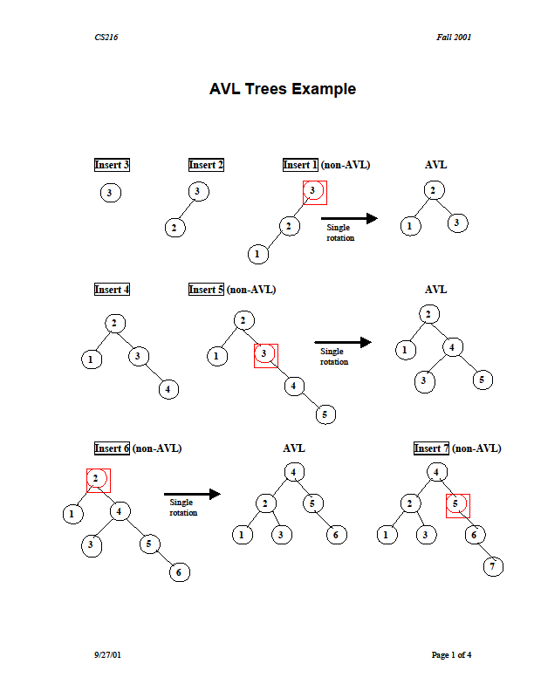
Insert 3,2,1,4,5,6,7,16,15,14

Slide 66
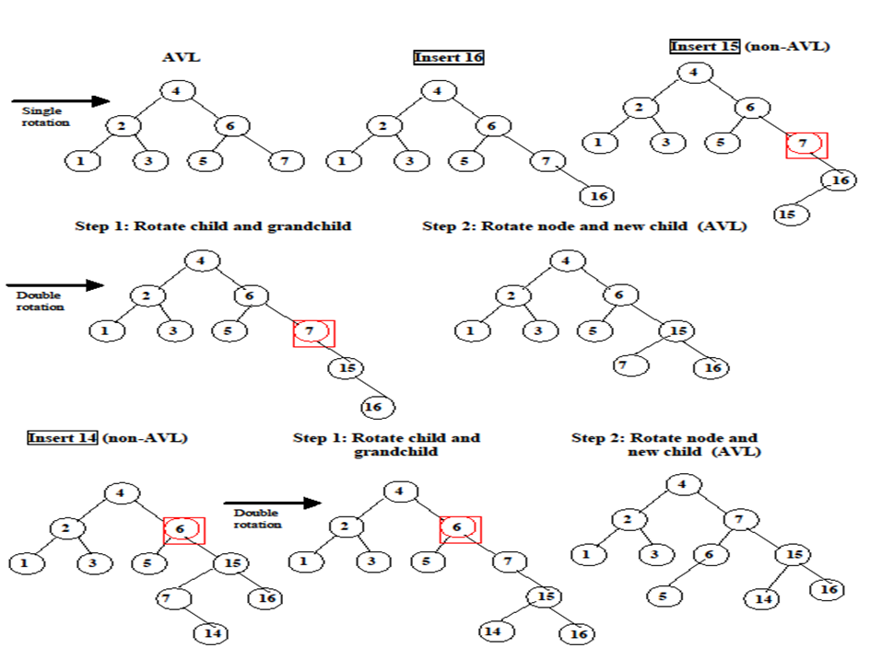
Insert 3,2,1,4,5,6,7,16,15,14

Slide 67
Sources used
Lectures by Mr. Mohammad Asad Abbasi

